Slide 1
Deep Dive in C# 7
λ
Bassam Alugili
25.01.2017

Slide 2
Agenda
Hitory and reasons
Binary Literals and Digit Separators
Out var
Local Functions
Ref Returns
Throw expressions
Expression-bodied
Async
Destruction
Tuples
Pattern Matching
λ

Slide 3
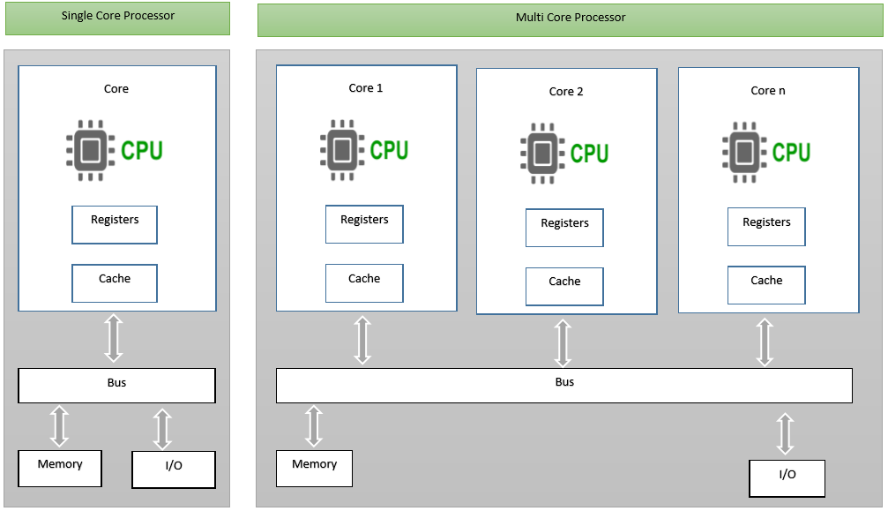
New Generation of Processors
~72..2007
Imperative is perfect
2007… until the next computer generation
Functional Programming is better.
Quantencomputer?
Physical Limitations.
λ
Notes:
https://github.com/dotnet/roslyn/issues/98

Slide 4
New Generation of Data
NoName web services
Microsoft web services
My
web services
My Company
Google web services
Amazon web services
λ

Slide 5
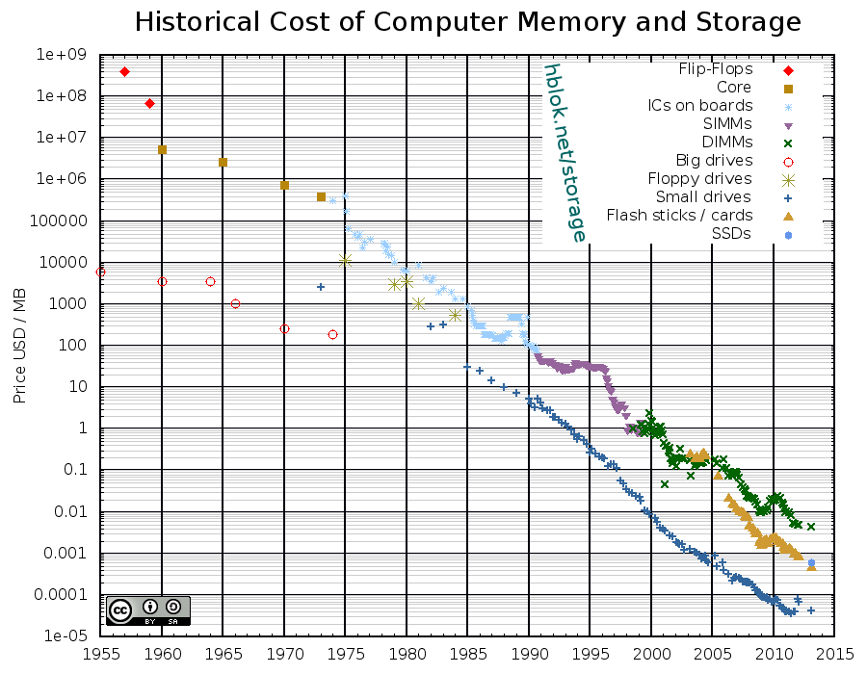
RAM is Cheap
λ
Source :https://hblok.net/storage_data/storage_memory_prices-2013-02.png

Slide 6
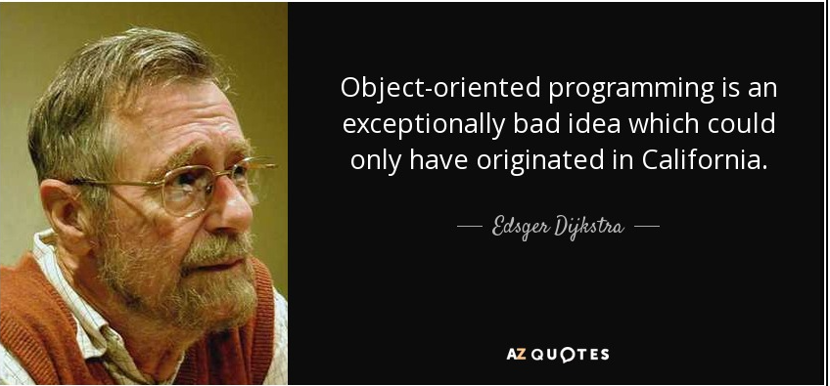
Reasonable and Mathematic I
λ

Slide 7






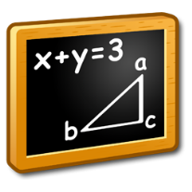


Reasonable and Mathematic II
OOP
Time
λ

Slide 8
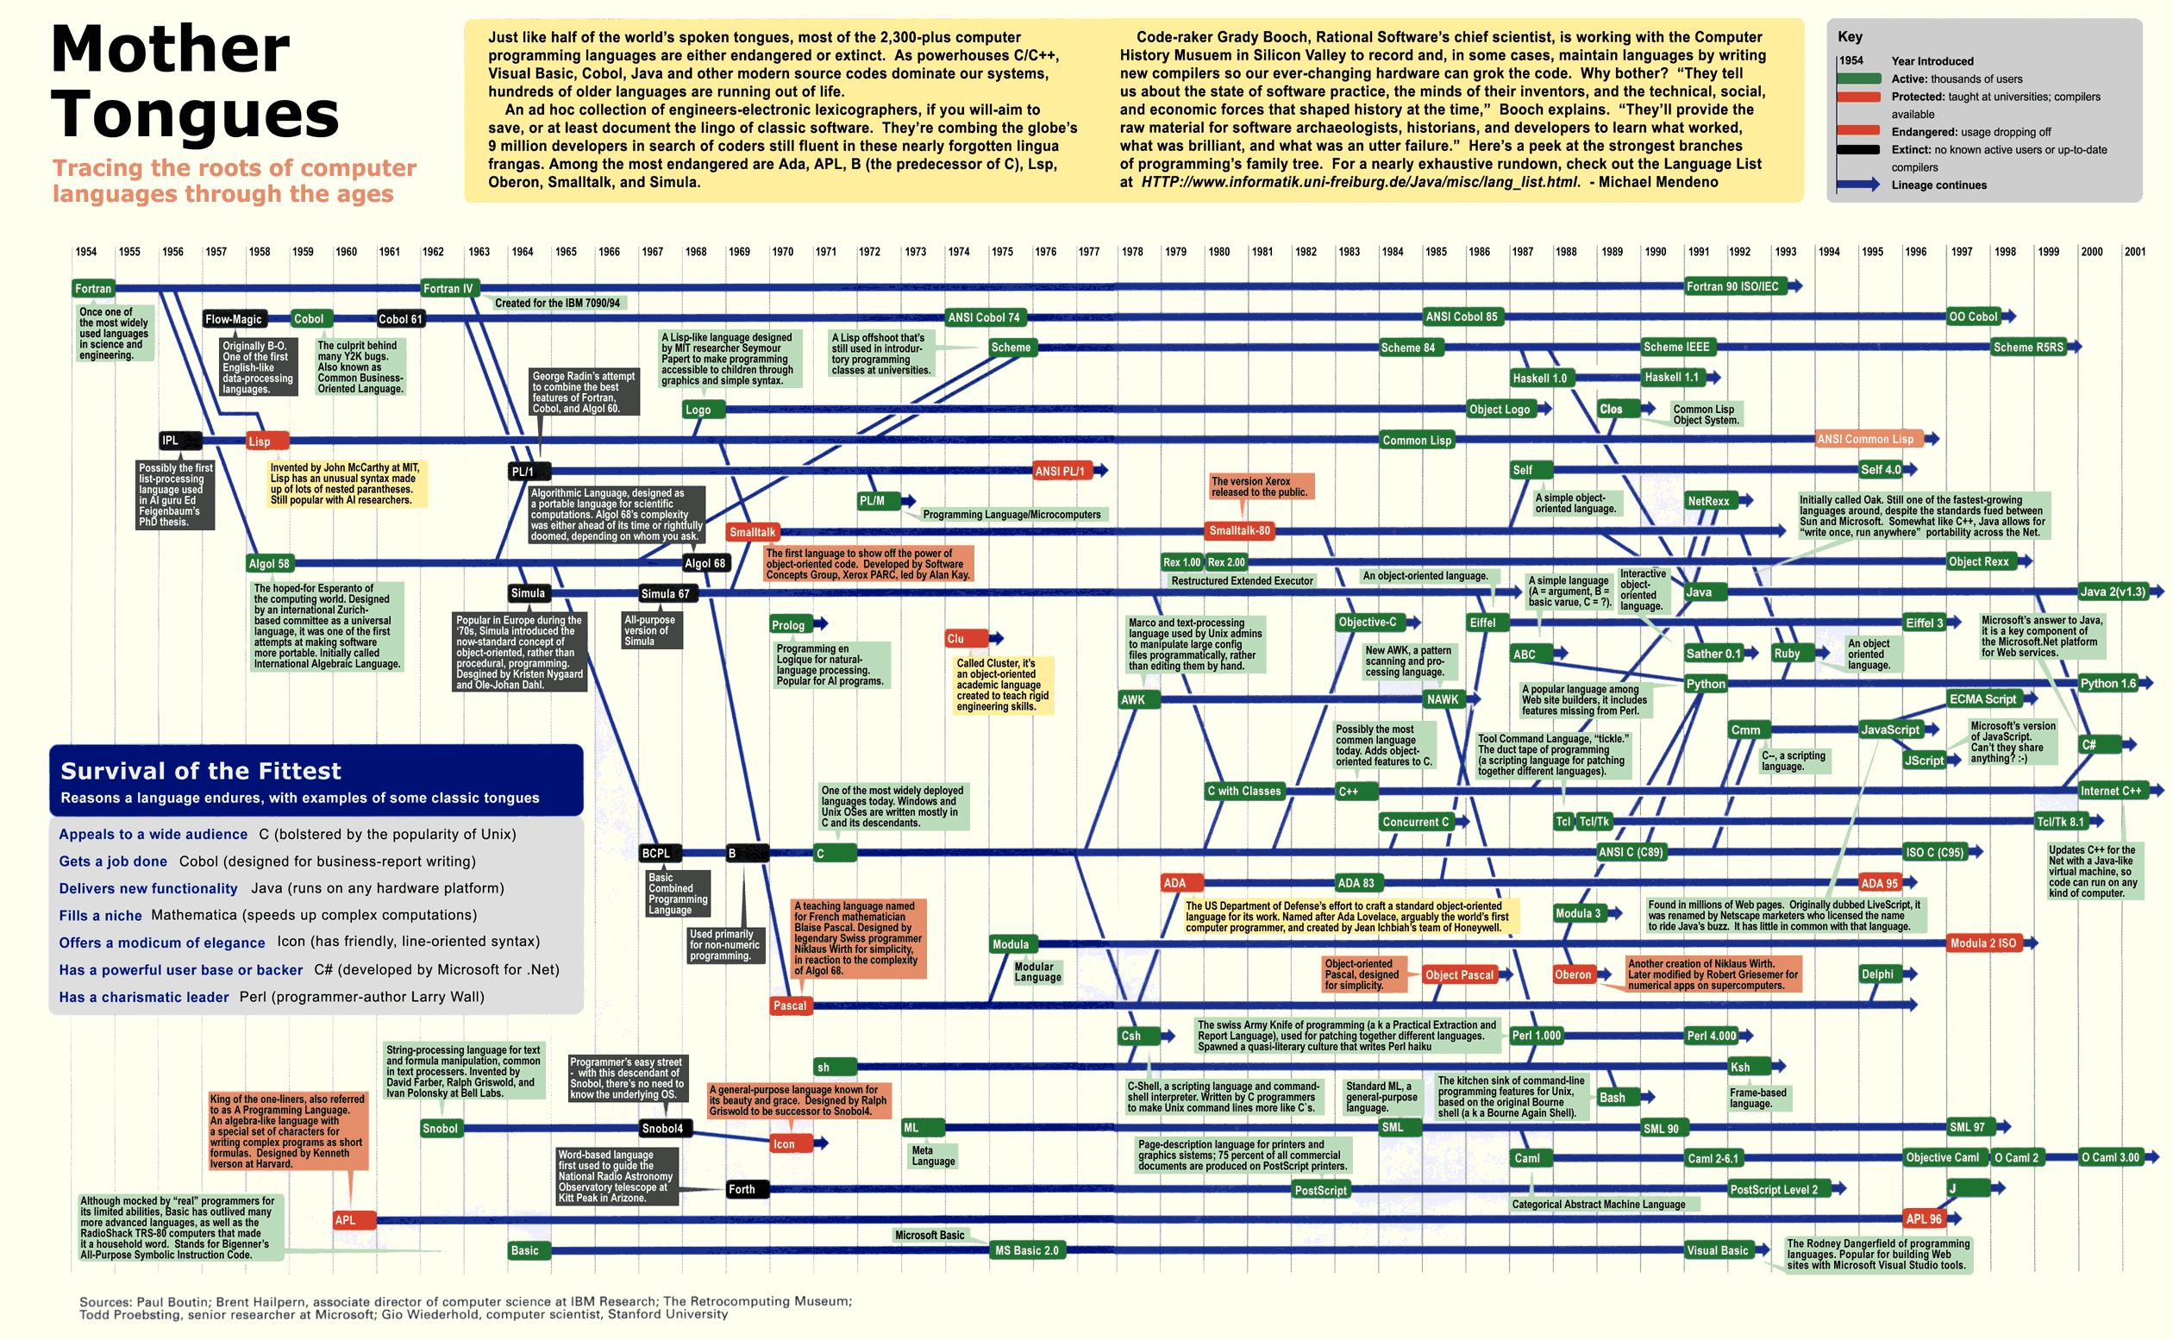
Simplicity
λ

Slide 9
C # 7 Features
C# 7
Tuples
Destruction
Pattern Matching
Local Functions
Ref Returns
Throw expressions
Expression-bodied
Async
Out var
Binary Literals and Digit Separators
λ

Slide 10
Binary Literals & Digits Separators
New tokens improve readability for numeric constants
int binary = 0b1001_1010_1001_0100;
int hex = 0x1c_a0_41_fe;
double real = 1_00.99_9e-1_000;
C# 7
λ

Slide 11
Out variables
Declare out variablie inline
public static void OutOldStyle(string @int)
{
// Ugly formality
int tmpInt;
int.TryParse(@int, out tmpInt);
Console.WriteLine(tmpInt);
}
C# 7
λ

Slide 12
Local Functions
Nesting functions inside other functions to limit their scope and visibility
Better performance
Reduced memory pressure
C# 7
λ
Notes:
First, they don't require you to allocate a delegate to hold them. Not only does this reduce memory pressure, it also allows the function to be in-lined by the compiler.
Secondly, they don't require you to allocate an object when creating a closure. Instead it just has access to the local variables. Again, this improves performance by reducing GC pressure.

Slide 13
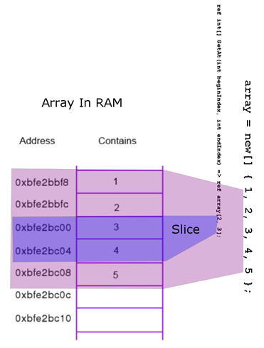
Ref Returns
var array = new[] { 1, 2, 3, 4, 5};
ref int GetItem(int[] arrayParam, int index) => ref arrayParam[index];
ref int item = ref GetItem(array, 1);
C# 7
λ

Slide 14
Throw expressions
You can throw exceptions in code constructs that previously were not allowed because throw was a statement
Null coalescing expressions
Some lambda expressions
Expression-bodied
C# 7
λ

Slide 15
Expression-bodied
C # 6 expression-bodied members expanded
Constructors
Finalizers
Indexers
C# 7
λ

Slide 16
Generalized async return I
Define custom return types on async methods
ValueTask
Designed for the very scenario
C# 7
λ

Slide 17
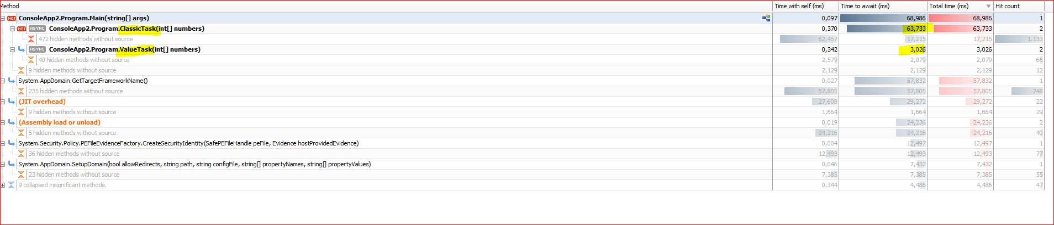
Generalized async return II
C# 7
λ

Slide 18
Tuples
C# 7
A tuple is a data structure that has a specific
number and sequence of elements
ValueTuple
Immutable
// Tuples Old C# Style
var tuple = new Tuple<int, int>(1, 2);
var sum = new Tuple<int, int>(1, 20);
var first = sum.Item1;
var count = sum.Item2;
Console.WriteLine($"item1 {sum.Item1} item2 {sum.Item2}");a
// Tuples C# 7 Style
var tupleNew = (1, 2);
var sumNew = (first: 1, count: 20);
Console.WriteLine($"first {sumNew.first} count {sumNew.count}");
λ

Slide 19
Destruction
Destruct an object to a tuple
C# 7
λ

Slide 20
Pattern Matching
Pattern matching (similar to a `switch` statement that works on the “shape” of the data, for example its type, rather than just the value)
Constant patterns
Type patterns
Var patterns
// C# 6
var cSharpOld = string.Empty;
var str = cSharpOld as string;
if (str != null)
{
// Code that uses str
};
// C# 7
if (cSharpOld is string strTmp)
{
// Code that uses strTmp
};
C# 7
λ

Slide 21
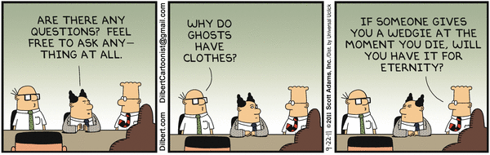
?
λ

